Slide 1
Agile Methodology
By Matthew Powers

Slide 2
Roles of Agile
Product Owner
Acts as bridge between customer/end user/VIPs and development team
Describes customer value of various tasks in product backlog
Works with development team in backlog refinement meeting
Scrum Master
Provides coaching as necessary
Assists the development team in reduction of impediments which arise
Works with development team and product owner on product and sprint backlog

Slide 3
More Roles of Agile
Developer
Works together with product owner, scrum master and testers on sprint and product backlog
Behaves professionally including coming in on time
Works together with the rest of the team to create a quality product
Tester
Works with Product Owner to write test cases
Works closely with developers to design a secure product

Slide 4
Phases of Agile
An agile project is broken up into sprints, each 2-4 weeks long and containing the following (Cobb, p. 40):
Product Backlog refinement meeting
The product owner and the rest of the team identify what is truly important
They break up the tasks at the top as much as they can by examining details of their construction
Sprint planning meeting
The development team decides what they can truly accomplish during the course of the sprint
Daily scrum
Everyone on the team works to keep one another on track during the course of the sprint
Sprint review
The team displays what they've accomplished to end users and VIPs
The team receives input from end users and VIPs about new features or updates to existing ones
Sprint retrospective
The team reviews the actions they've taken so far and changes as necessary

Slide 5
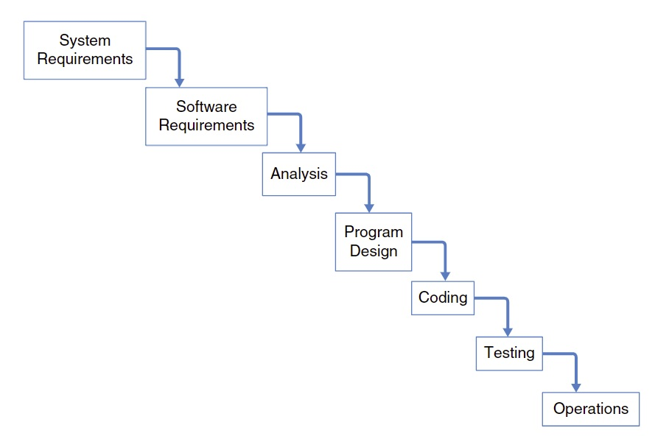
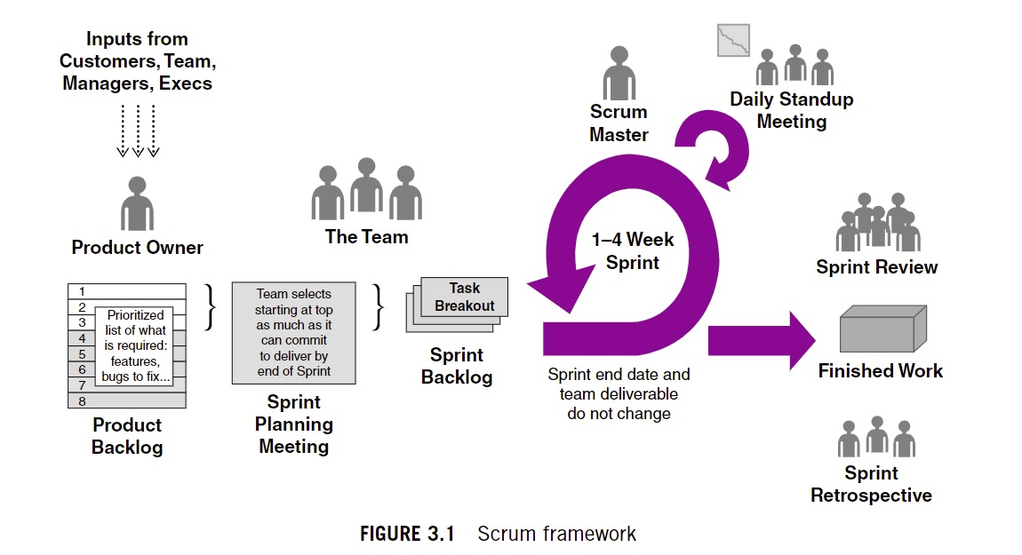
Waterfall vs Agile
Waterfall
Agile
In the above comparison, the waterfall methodology (Cobb, p. 18) would have spanned the entire lifetime of the project as opposed to a smaller sprint (Cobb, p. 39). Change to the project is not accepted. This results in a siloed workload for each sub-team.

Slide 6
Choosing Waterfall or Agile
Top things to consider when choosing one, the other or a hybrid approach:
Is the company familiar with agile?
If the company is unfamiliar with agile and still wants both accountability and possible change in requirements, then a hybrid approach may be best. It will allow for that change and the oversight from end users and VIPs while still allowing the team to work in a way that they feel comfortable. If they are familiar, then they can choose that.
Is the team capable of working closely together?
If the company is capable of working closely together, then a true agile methodology is great. It will allow each team member the communication with other members who have a different view point providing a product much closer to what the end user would want. If not, they can silo themselves to their own particular team working along the waterfall.

Slide 7
More Things to Consider
How is the communication on the team?
If communication amongst the team members is in good shape, agile will allow them to use that to construct a product that fits the team's overall idea of done. If not, a classical waterfall model will allow them best to work in a way that feels comfortable to them.
Does the team require feedback from VIPs or customers?
If they do need feedback, then either a hybrid approach or typical agile will work to provide that feedback. Otherwise, a waterfall will be fine
Are the requirements prone to changing?
If so, an agile approach will be better. Assuming the requirements are laid out plainly, a waterfall model will allow for that approach and the team can budget their time appropriately.

Slide 8
References
Charles G. Cobb. (2015). The Project Manager’s Guide to Mastering Agile : Principles and Practices for an Adaptive Approach. Wiley.

